Slide 1
Engineering Design DSN2096
By:
Ramraj Dangi

Slide 2
Syllabus
Introduction to Engineering design process: Design History; Dieter Rams Principles of Good Design; Overview of Engineering Design Process: Problem Formulation, Concept generation, Project Planning and Design Making; Human Centred Design (HCD);
Design Thinking for Innovation: Design Thinking as Mindset, Process and Toolbox., Enhancing Design Thinking Through, Empathy, Interviewing, Questioning & Brainstorming, Tools for Design Thinking: Mind Mapping, Innovation Flowchart – Question ladder – SCAMPER (for products) Journey Mapping, Task analysis grid (for services)
Engineering Design Approaches: Professional and societal Context of Design; Different types of design – Conceptual, Embodiment designs and Detailed designs – Identification and Specifications, Standards and codes, Design Features – Design for Aesthetics, Production, Standards, Minimum risk, Ease of maintenance, Quality, Minimum cost and Optimum Design, Service Design - People - Asserts - policies - culture. Iterative process - Exploration - Creation - Reflection - Implementation.

Slide 3
Syllabus
Usability & Reliability: Usability – User requirement; User experience; Usability testing; Customer Co-creation; Reliability & Safety: Human and equipment, safety, Risk analysis, and security, System reliability; Use of e-engineering: Modelling, Simulation and Verification.
Prototyping and Visualization: Design Cycle Model, Metaphor method: Theory and methodology of concept generation, Blend method & Thematic Method. Conceptual Design & Design capability and sociality. Prototyping & Visualization Design Tools – E-tools
Sustainable Design: Concepts of sustainable development, Sustainable design principles - Design for Environment; Life Cycle Assessment; Models of sustainable design- Biomimicry, Eco Design, Recycling; Social Innovation
Communication: Articulating design ideas: Storytelling; Sketching & Dynamic Diagrams; K Scripts

Slide 4
Books and resources
TEXT BOOKS:
Huge Jack, “Engineering Design, Planning, and Management” Academic Press, 2013.
Gerhard Pahl, Wolfgang Beitz “Engineering Design: A Systematic Approach” 2014.

Slide 5
Unit4: Usability & Reliability

Slide 6
User Requirements
User Requirements define how to meet the physical and cognitive needs of the intended users of your website or application.
Users should be able to comfortably and effectively use an interface to accomplish the goals that it has been designed to support.
When you can clearly define who will be using your interface, and the environment(s) in which it will be used, you can specify User Requirements.
A Contextual Task Analysis is one method you can use to gain insights about how and where your users expect to use your interface, by observing how they currently perform a task that your interface will, or already does, support.
If you learn that a majority of your intended users have impaired vision, hearing, or motor skills, you may need to design your interface to support accessibility.
For example, website form fields and error messages should support assistive devices such as text-to-speech readers. Another example is providing the ability to adjust font size (e.g., small, medium, large) to help users with impaired vision, which may include someone who does not always wear his or her glasses.

Slide 7
Usability Requirements
An interface should be easy to learn how to use and easy to remember how to use. The latter pertains especially to devices that require infrequent use. Users should not be required to consult a manual each time they need to use a kitchen blender for instance. Bank ATMs and web-based forms, which may be used by anyone, should be simple to use the first time around without instructions.
Usability Requirements for an interface design should support the following from the perspective of its primary users:
Efficiency of use: goals are easy to accomplish quickly and with few or no user errors
Intuitiveness: the interface is easy to learn and navigate; buttons, headings, and help/error messages are simple to understand
Low perceived workload: the interface appears easy to use, rather than intimidating, demanding and frustrating
NOTE: Your usability requirements should describe the context of use: who, what, when, where, and why. “The specific activities the requirements describe should reflect both a range of user goals that the system must support and business goals for creating the new system.

Slide 8
User Experience Requirements
User Experience Requirements have an impact on all other requirements. This is because in a User-Centered Design (UCD) process, users come first.
Specifically, user needs and preferences for an interface design should be supported to the extent that they provide users an enjoyable experience and the means to complete their task goals with ease.
A user’s experience can be enhanced by adding elements of delight to user interactions. Delight may manifest as unexpected (by users) shortcuts that allow a user to complete a common task more efficiently, or through the language used on a website — when you speak the users’ language, you gain user trust.
To thoroughly understand user needs and preferences, conduct user research, such as one-on-one structured interviews, focus groups, and ethnographic observations.

Slide 9
Usability and User Experience (UX)
Usability is the degree of ease with which products such as a device , a software or any web applications can be used to achieve required goals effectively and efficiently.
Difference with UX:
Usability is concerned with the “effectiveness, efficiency and satisfaction with which specified users achieve specified goals in particular environments” (ISO 9241-11) while user experience is concerned with “all aspects of the user’s experience when interacting with the product, service, environment or facility”.
In terms of a web site, the aim of usability is to make that website easy to use while the aim of user experience is to make the user happy before, during and after using that website.
Usability can be modelled as the question “Can the user accomplish their goal?” while user experience can be phrased as “Did the user have as delightful an experience as possible?”

Slide 10
Usability Testing
Usability testing refers to evaluating a product or service by testing it with representative users. Typically, during a test, participants will try to complete typical tasks while observers watch, listen and takes notes. The goal is to identify any usability problems, collect qualitative and quantitative data and determine the participant's satisfaction with the product.
Why Usability Test?
The goals of usability testing vary by study, but they usually include:
Identifying problems in the design of the product or service
Uncovering opportunities to improve
Learning about the target user’s behavior and preferences

Slide 11
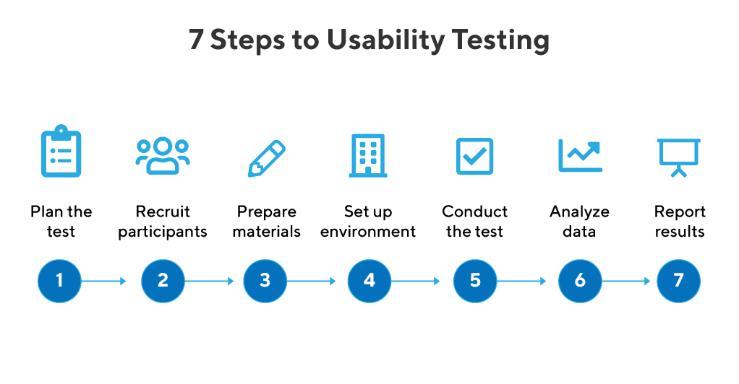

Slide 12
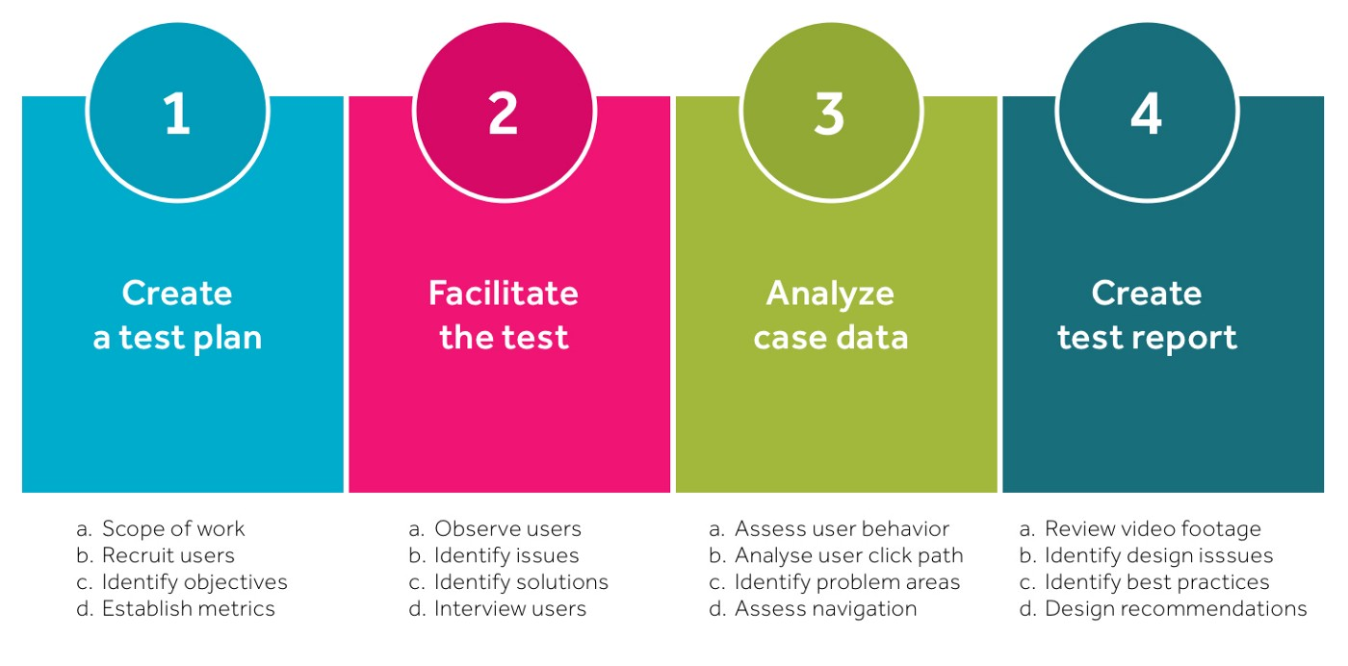

Slide 13
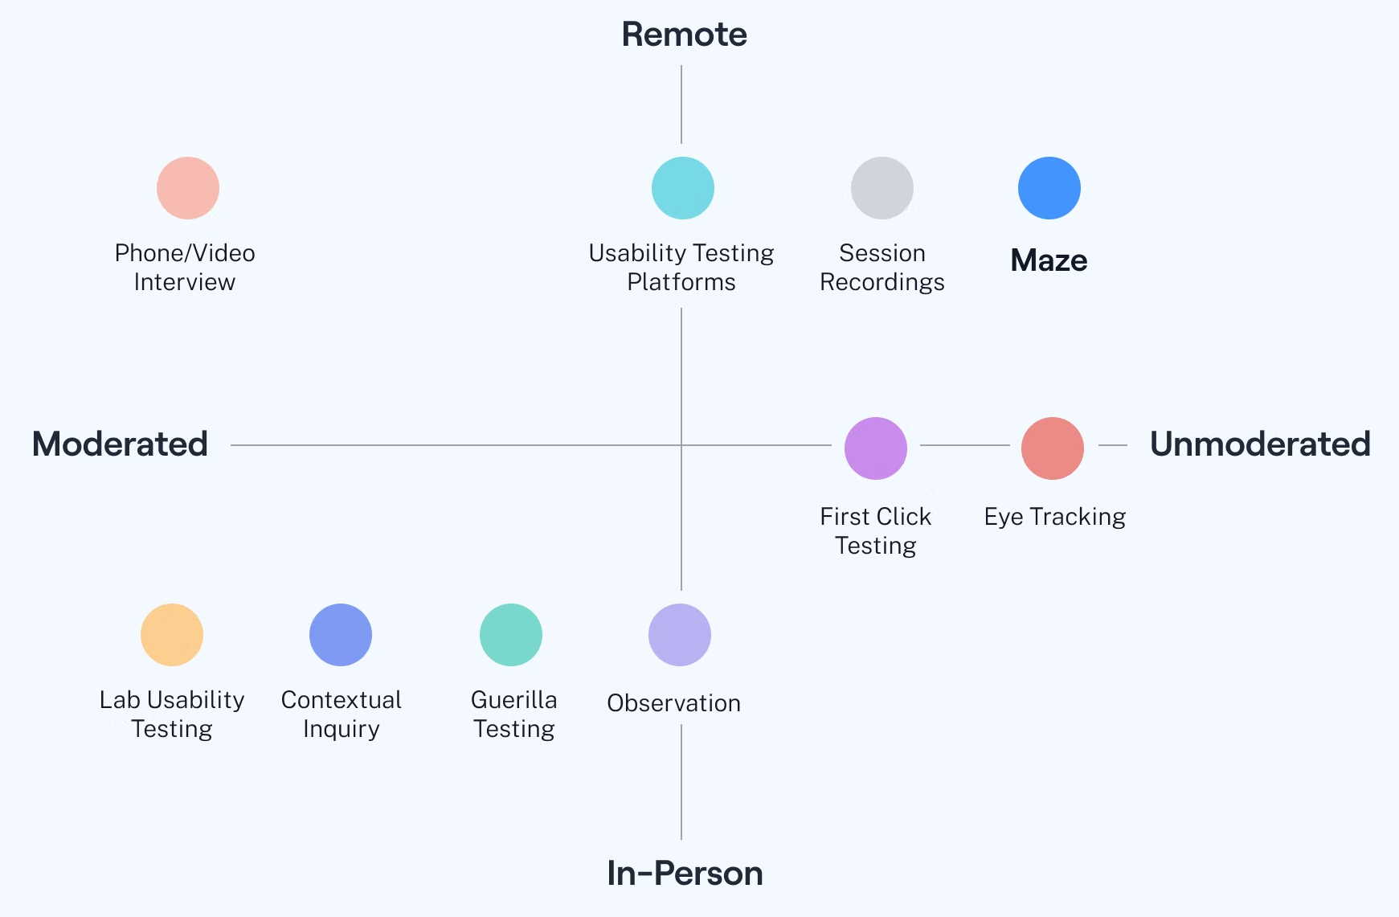
Usability Testing Methods

Slide 14
Objectives of User Testing
Gain insights from our users
See if we meet user’s expectations
Check if the design is matching business decision to real world use
Check if the user can perform the tasks we proposed
Find out if we’re on the right track
Get user reactions and feedback

Slide 15
What are the elements of Usability Testing?
Explain Types of Usability Testing?
Assignment:: PowerPoint Presentation

Slide 16
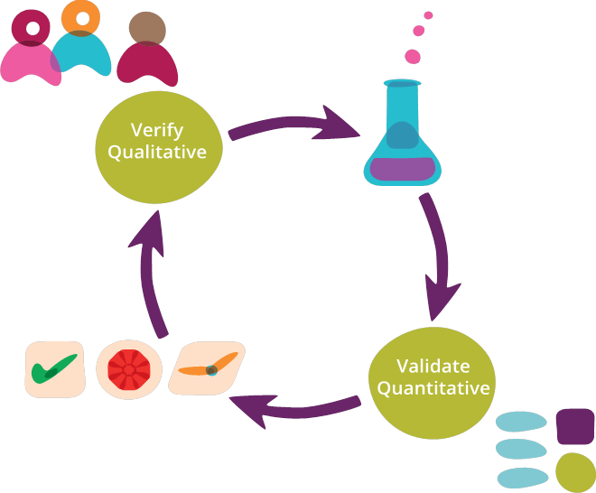
Customer Co-creation
Co-creation strategy that aims to bring together different groups of people, typically bringing in a third party, to assist with product development or creative processes.
In essence, customer co-creation requires contribution from external parties, be it customers, stakeholders, online crowd forums etc.

Slide 17
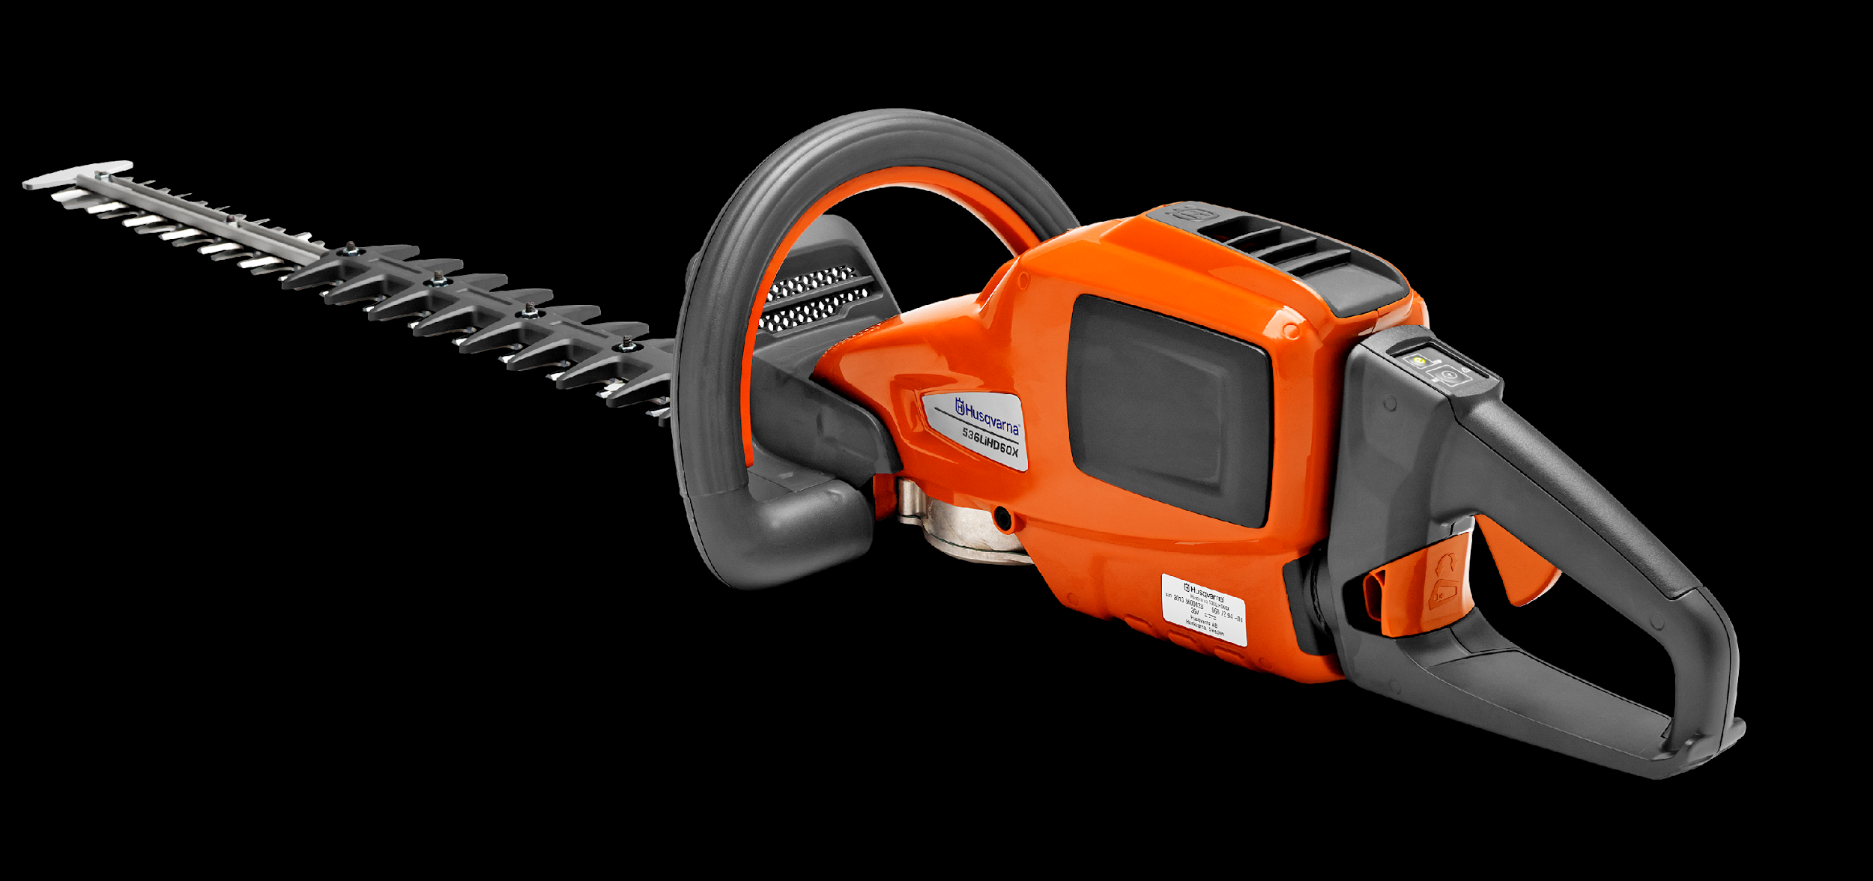
Reliability and Safety
There is no distinct line between reliability and safety. Most systems must be both reliable and safe. In theory, safe systems may be unreliable, while reliable systems may be unsafe. Nevertheless, systems can be designed in order to be both safe and reliable, but it is very rare that both requirements are equally important.
Meanings
Reliable :: consistently good in quality or performance; able to be trusted
Safe :: protected from or not exposed to danger or risk; not likely to be harmed or lost.
Example 1: Safe but unreliable:
A smoke detector producing many false alarms. As long as potentially dangerous smoke is detected reliably, the smoke detector can be considered safe.
By producing many false alarms, the smoke detector is considered unreliable because it announces dangerous situations while in reality everything is safe.

Slide 18
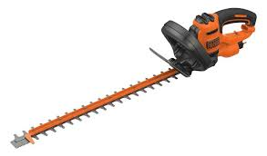
Reliability and Safety
Example 2: Reliable, but unsafe:
An old hedge trimmer. There is only one switch to operate the hedge trimmer. If pressed, the trimmer starts immediately with full speed.
Due to its simplicity, the electrical part of such a hedge trimmer would be more reliable than those trimmers available today.
Today's hedge trimmers have at least two switches. Both switches must be activated in order to operate the trimmer, and the switch positions are such that you will need both hands in order to activate them. Additionally, modern hedge trimmers have a soft start which inherently serves as an announcement function for the operator.
Beyond any reasonable doubt, these features make modern hedge trimmers safe. The downside effect is that, due to more electrical parts involved, modern trimmers are relatively unreliable.

Slide 19
Reliability and Safety
Example 3: Reliable and safe Railroad crossing, controlled by three independent and redundant controllers. Each controller would be able to handle the railway crossing on it's own. Under normal conditions, all three controllers yield identical outputs from input data. If one controller fails, there are still two controllers left in order to keep the railroad crossing in a safe state.
This system is safe and reliable at the same time:
Safe: 2 of 3 controllers must yield identical results,
Reliable: The loss of one controller can be tolerated.

Slide 20
Risk Analysis
Performing a risk analysis includes considering the probability of adverse events caused by either natural processes, like severe storms, earthquakes or floods, or adverse events caused by malicious or inadvertent human activities; an important part of risk analysis is identifying the potential for harm from these events, as well as the likelihood that they will occur.
Many industries have recognized the increasing importance of risk analysis such as:
Medical
Food and beverage
Automotive
Transportation
Military
Aerospace
Nuclear & many more…

Slide 21
Benefits of Risk Analysis
Performing a risk analysis includes considering the probability of adverse events caused by either natural processes, like severe storms, earthquakes or floods, or adverse events caused by malicious or inadvertent human activities; an important part of risk analysis is identifying the potential for harm from these events, as well as the likelihood that they will occur.
identify, rate and compare the overall impact of risks to the organization, in terms of both financial and organizational impacts
identify gaps in security and determine the next steps to eliminate the weaknesses and strengthen security;
improve security policies and procedures and develop cost-effective methods for implementing these information security policies and procedures;
understand the financial impacts of potential security risks.

Slide 22
Risk Analysis in Project Mgmt.
A key process area in project management.
Helps deciding whether to proceed with a project or not.
Ensures only projects with the highest chance of success are selected.
Used in project planning and during project implementation to evaluate how a project can be successfully completed.
If risks are not considered and controlled,you will not be able to minimize their impact on the schedule,scope,cost or quality.
It is possible for a project to be stopped for example if the availability of resources become an issue,or the potential benefits might not be sufficient.

Slide 23
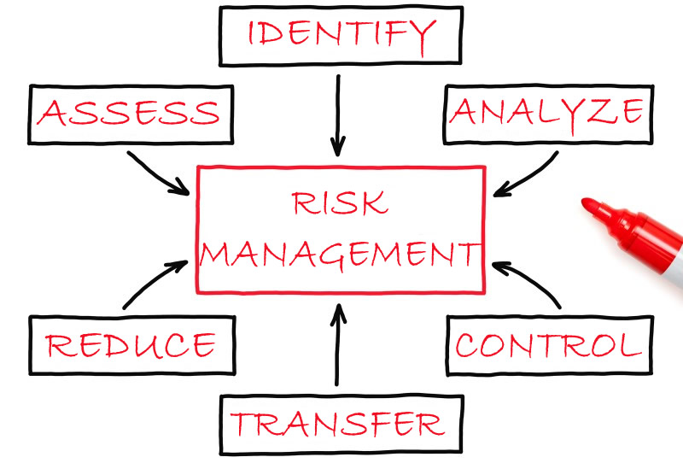
Steps in Risk Analysis Process
Conduct a risk assessment survey
Identify the risks
Analyse the risks
Develop a risk management plan
Implement the risk management plan
Monitor the risks

Slide 24
Helpful Questions for Identifying Risks
What do you want to achieve?
What will stop it being achieved?
What could go wrong?
Will the projected benefits be achieved as predicted?
Will the benefits be achieved at no extra costs?
Will the necessary resources be available?
What are the constraints,assumptions and dependencies?
Are there any potential issues beyond local control?

Slide 25
Security in Risk Analysis
Possible security measures
Transfer the risk, e.g. insurance
Reduce vulnerability
* Reduce likelihood of attempt
-e.g. publicise security measures in order to deter attackers
-e.g. competitive approach-the lion-hunter's approach to security
* Reduce likelihood of success by preventive measures
-e.g. access control, encryption, firewall
Reduce impact, e.g. use fire extinguisher/firewall
Recovery measures, e.g. restoration from backup

Slide 26
Security in Risk Analysis
Identify possible security measures
Decide which to choose
Ensure complete coverage with confidence that:
- The selected security measures address all threats
- The results are consistent
- The expenditure and its benefits are commensurate with the risks
Adding security measures changes the system
- Vulnerabilities may have been introduced
After deciding on security measures,revisit the risk analysis and management processes
e.g. introduction of encryption of stored files may remove the threat to
Confidentiality but introduce a threat to Availability
- What happens if the secret key is lost?

Slide 27
E-Engineering
Modelling,
Simulation &
Verification

Slide 28
Simulation and Modeling
The aspects of modeling and simulation that are particularly important in the context of design.
Modeling and simulation enables designers to test whether design specifications are met by using virtual rather than physical experiments.
The use of virtual prototypes significantly shortens the design cycle and reduces the cost of design.
It further provides the designer with immediate feedback on design decisions which, in turn, promises a more comprehensive exploration of design alternatives and a better performing final design.
Simulation is particularly important for the design of multi-disciplinary systems in which components in different disciplines (mechanical, electrical, embedded control, etc.) are tightly coupled to achieve optimal system performance.

Slide 29
Simulation, Modeling & Verification
Simulation Conceptual Model: "The developer's description of what the model or simulation will represent, the assumptions limiting those representations, and other capabilities needed to satisfy the user's requirements."
Verification: "The process of determining that a model implementation and its associated data accurately represent the developer’s conceptual description and specifications."
Verification answers the question "Have we built the model right?" whereas validation answers the question "Have we built the right model?”
Verification is an iterative process aimed at determining whether the product of each step in the development of the simulation model fulfills all the requirements levied on it by the previous step and is internally complete, consistent, and correct enough to support the next phase

Slide 30
Thanks!

